Slide 1
Face Recognition as Authentication Group 1
M Hudya Ramadhana
Mutia Ayu Dianita

Slide 2
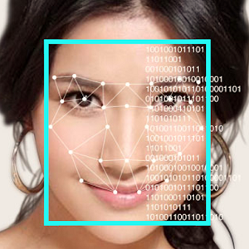
Background
Notes:
Hudya

Slide 3

Briefly Description : Security System
Notes:
Mutia

Slide 4
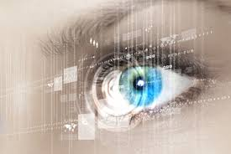
Definition of Biometric Security
Notes:
Mutia

Slide 5

Briefly Description : Authentication
Notes:
Hudya

Slide 6
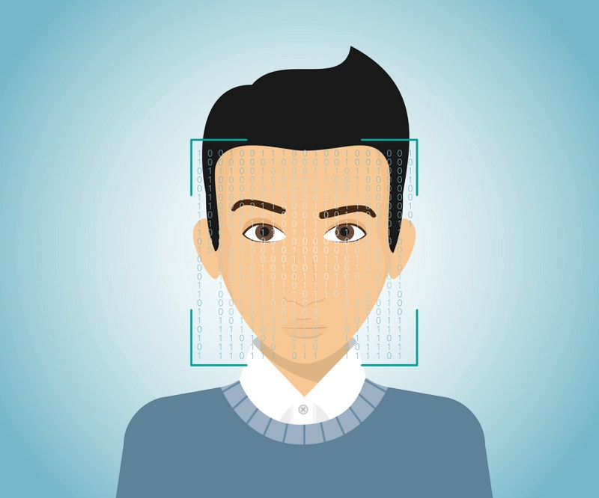
Face Recognition
Notes:
Hudya

Slide 7
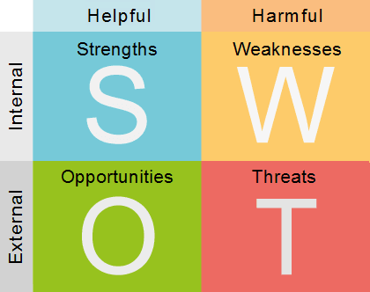
SWOT
Notes:
Mutia

Slide 8
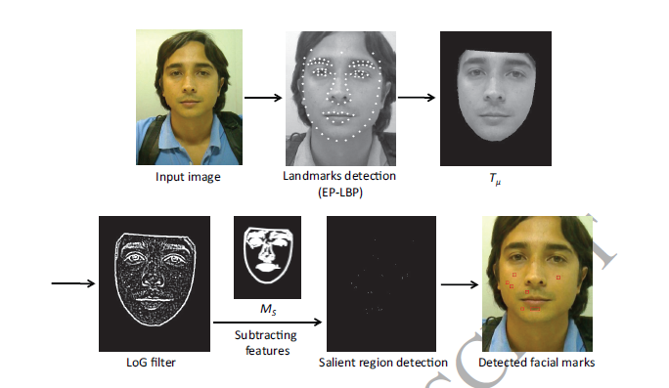
Authentication Process of Face Recognition
Notes:
Hudya

Slide 9
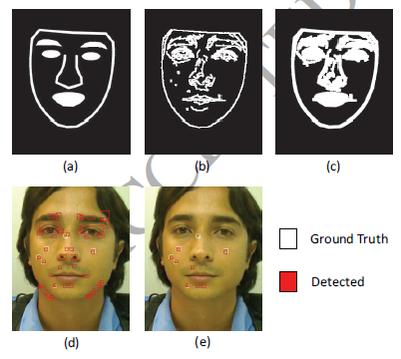

Slide 10
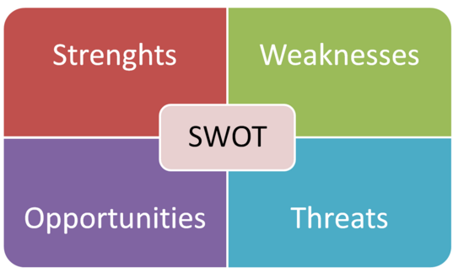
SWOT Analysis
Notes:
Hudya

Slide 11
THANKYOU
M Hudya Ramadhana
Mutia Ayu Dianita

